Slide 1
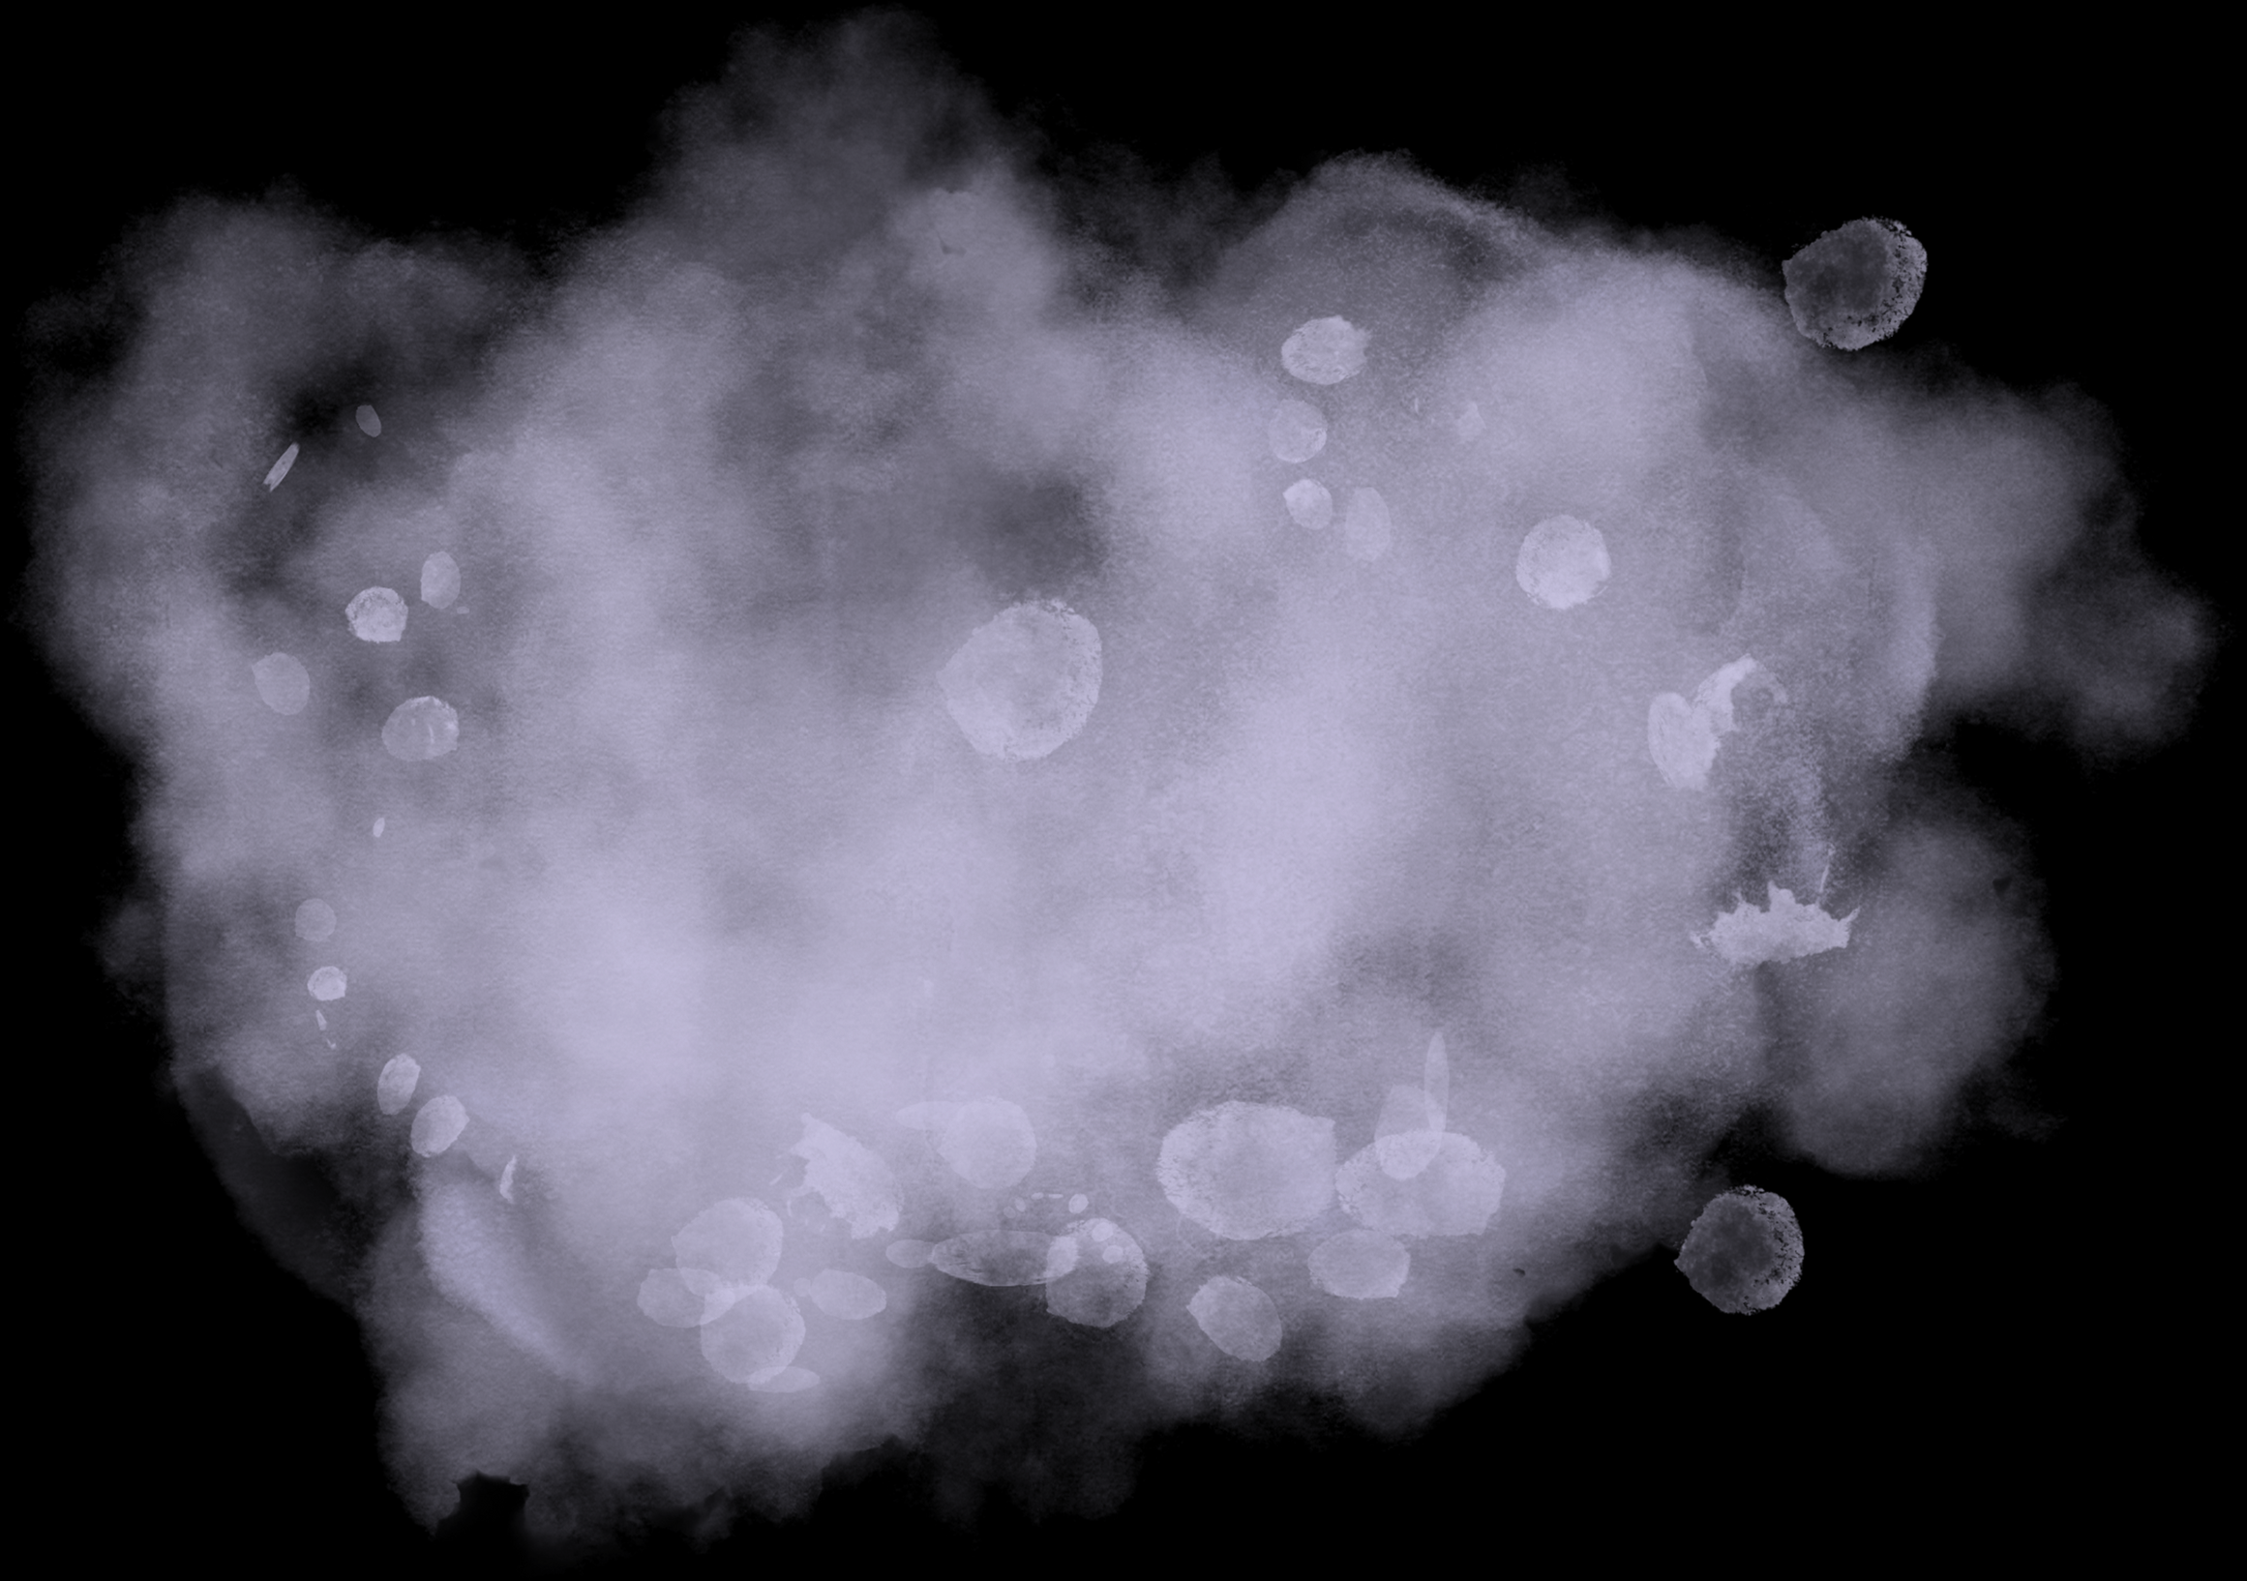
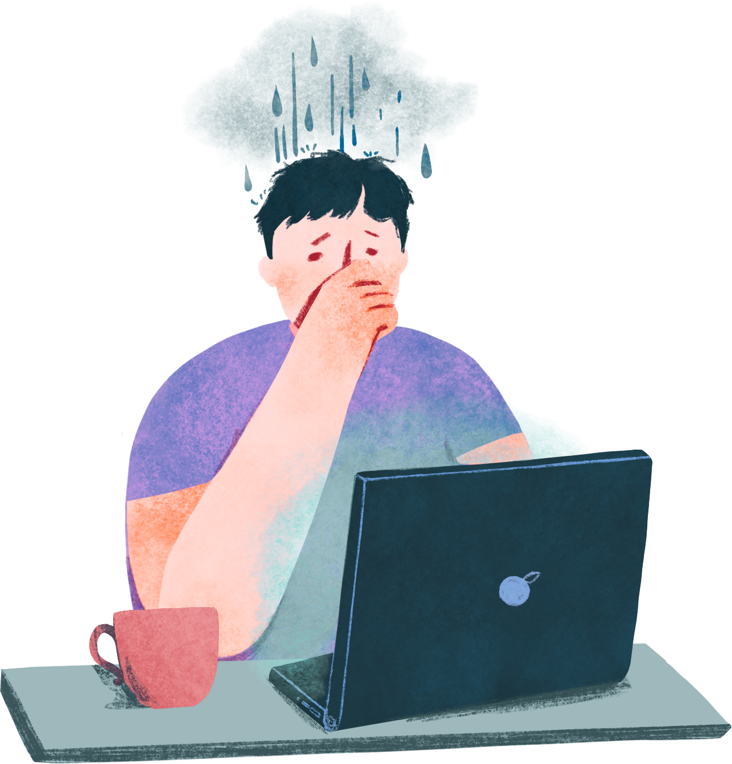
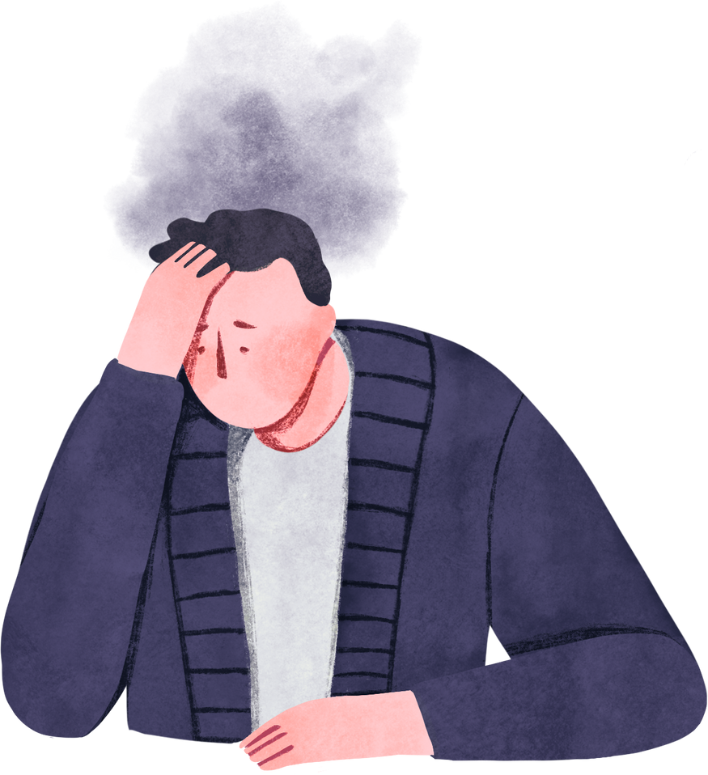
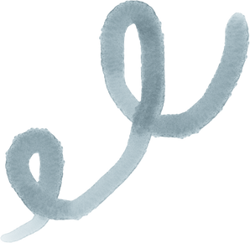
Work Health
Impact
How post-pandemic work arrangements influence mental health, physical well-being, and work–life balance across industries and regions.
Let’s begin the conversation that truly matters.

Slide 2
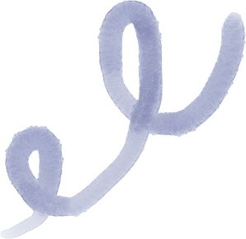
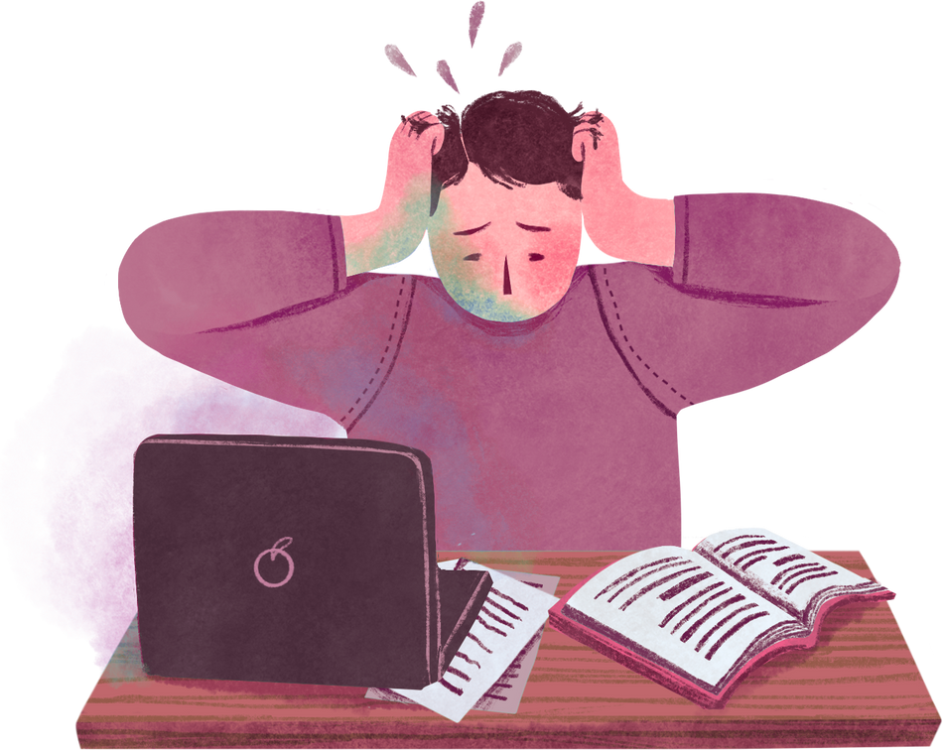
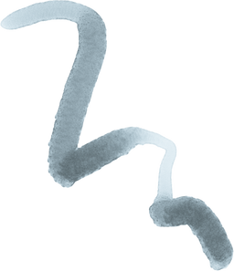
What is
Work Health Imact?
“Work Health Impact” simply means how someone’s job and working conditions affect their health.
Physical health – back pain, eye strain, headaches.
Mental health – stress, anxiety, burnout, depression.
Work–life balance – how well people can separate work time from personal life.

Slide 3
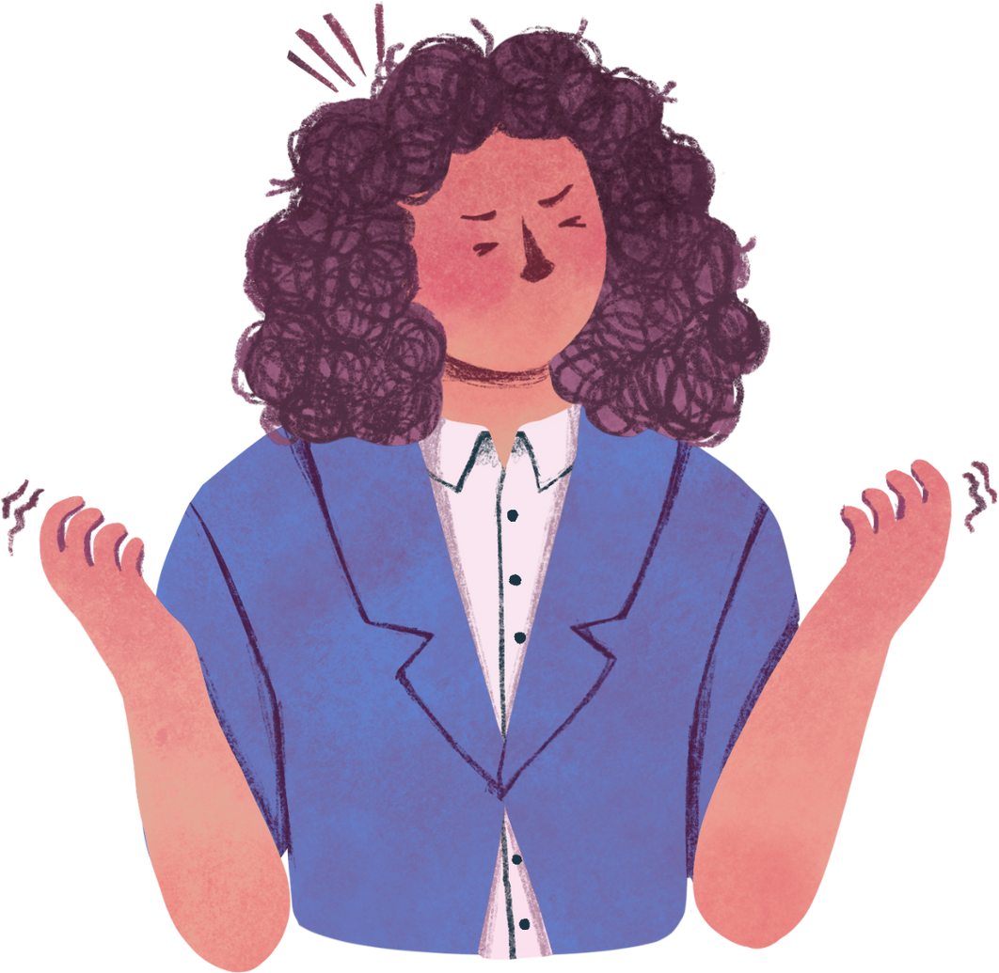

Data
OverView
The Post-Pandemic Remote Work Health Impact 2025 dataset provides a global view of how remote, hybrid, and onsite work arrangements affect employees’ mental and physical well-being after the pandemic. Collected in June 2025, it combines responses from a wide range of industries, regions, age groups, and job roles.
Important Columns
Work_Arrangement
Hours_Per_Week
Burnout_Level
Work_Life_Balance_Score
Physical_Health_Issues
Age
Mental_Health_
Status
Social_Isolation_
Score
Region

Slide 4
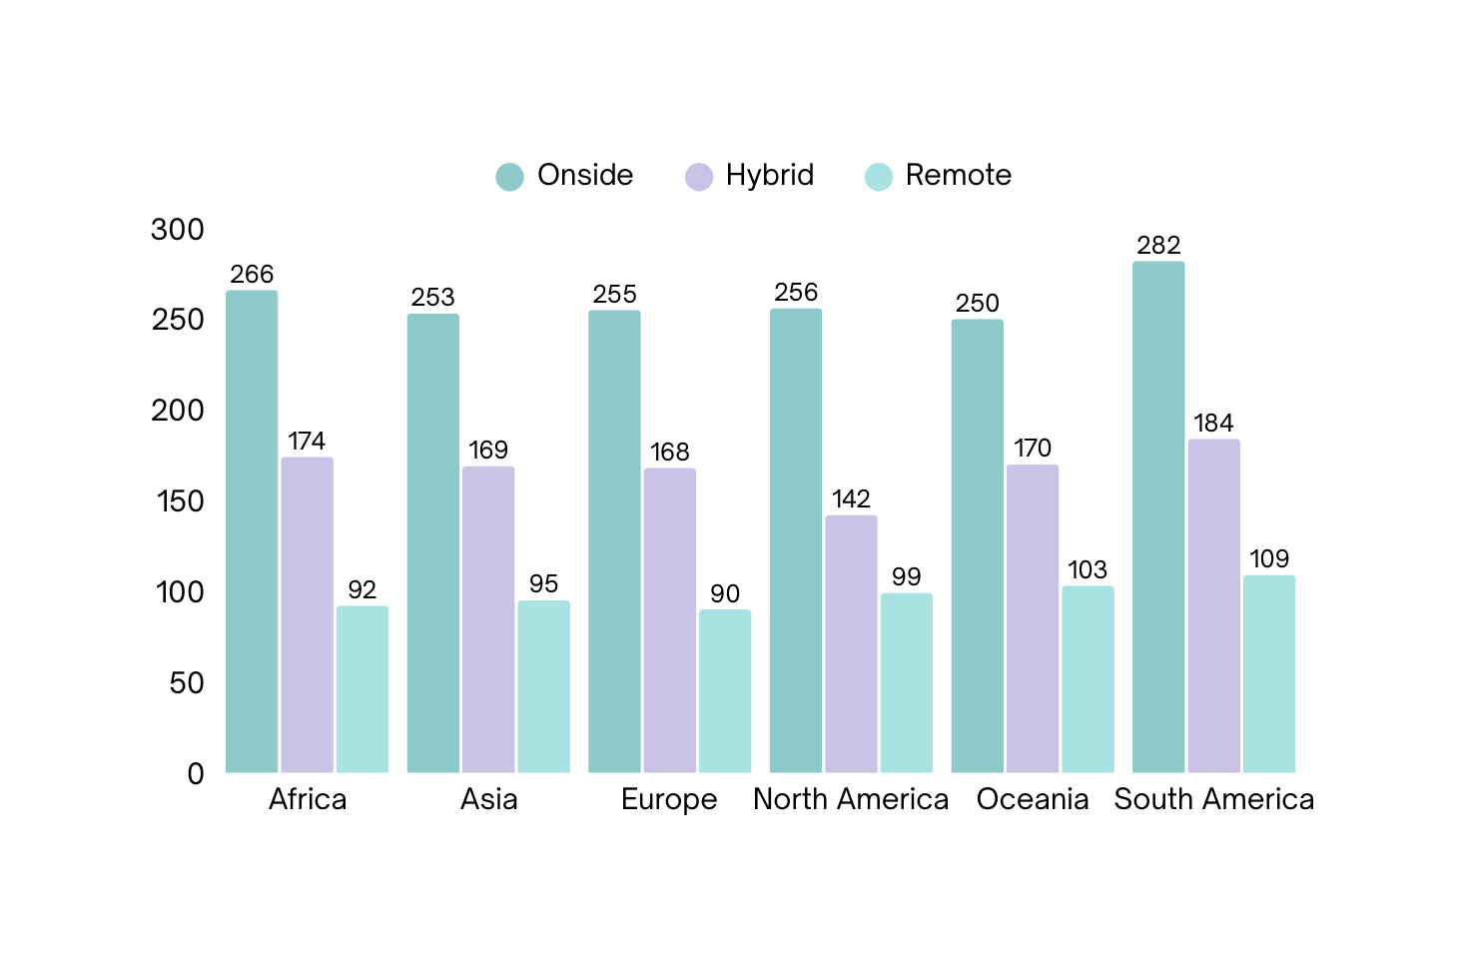

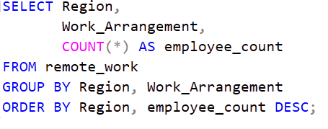
How is the workforce distributed across
Regions and work modes?

Slide 5
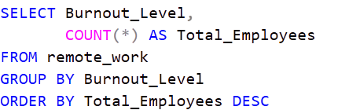
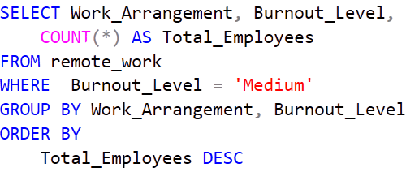
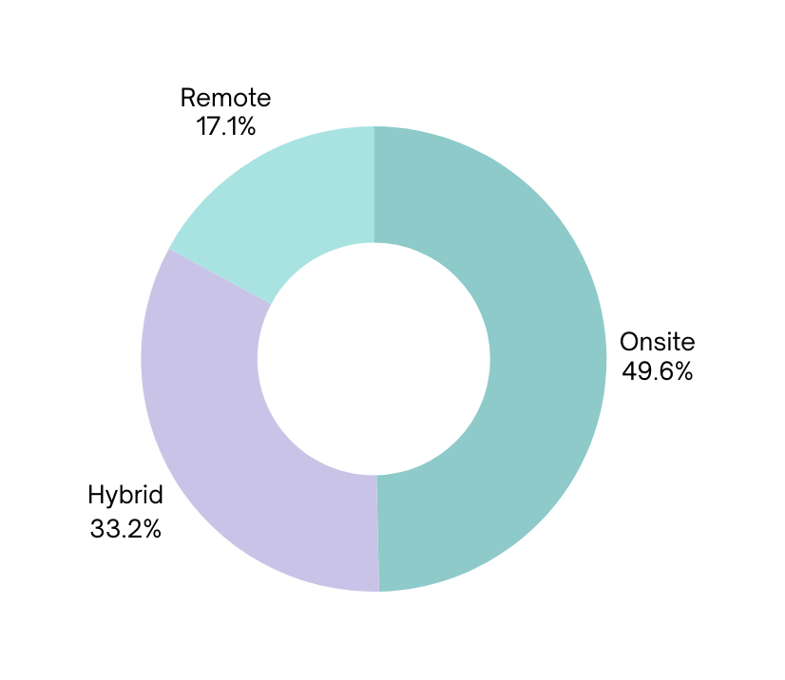
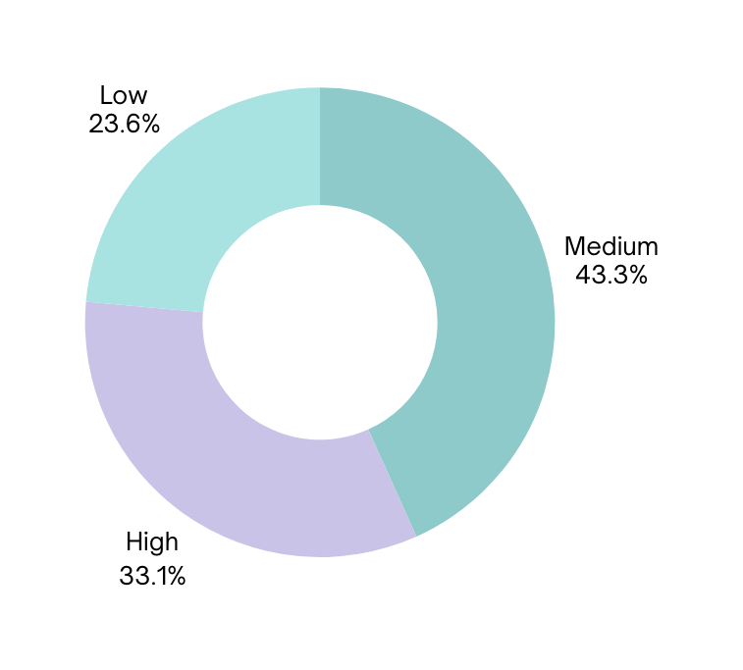
Common Burnout Level & Associated Work Mode

Slide 6
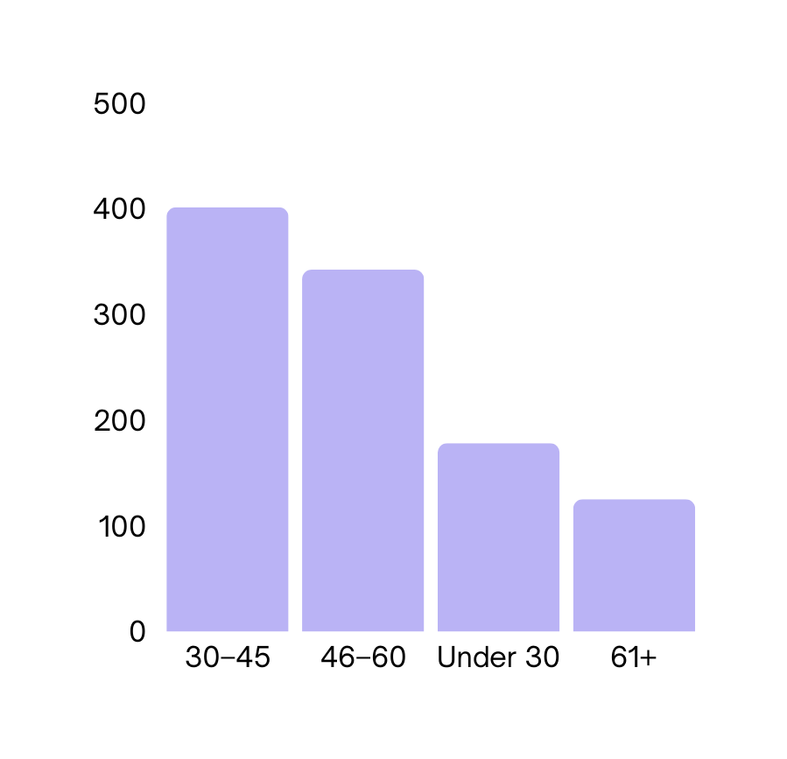
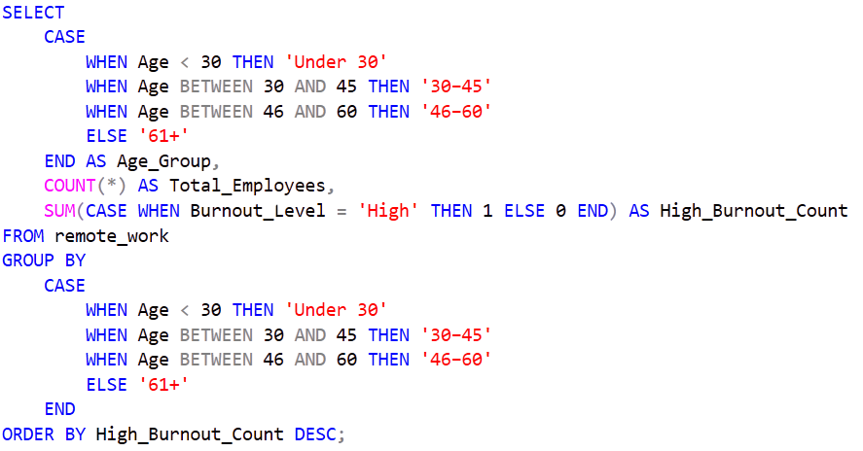
Which Age Group
Has the Highest Burnout?

Slide 7
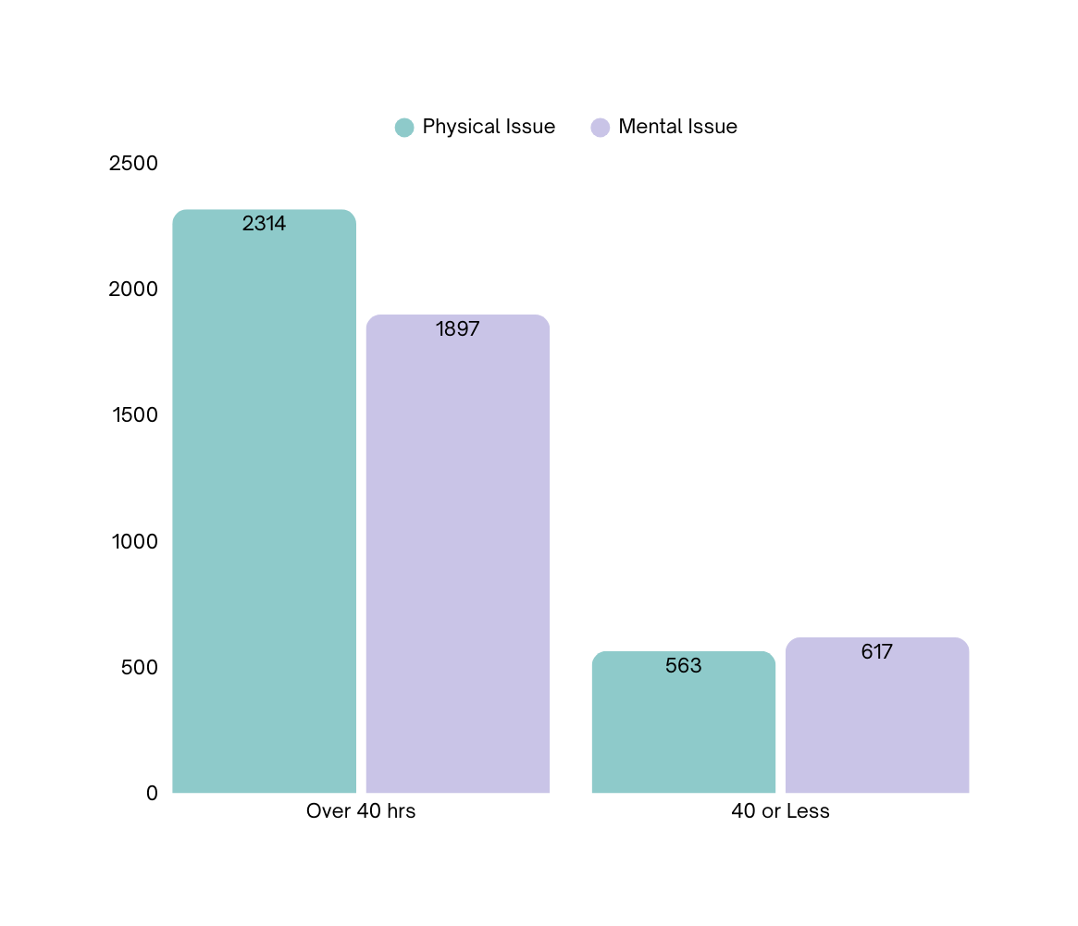

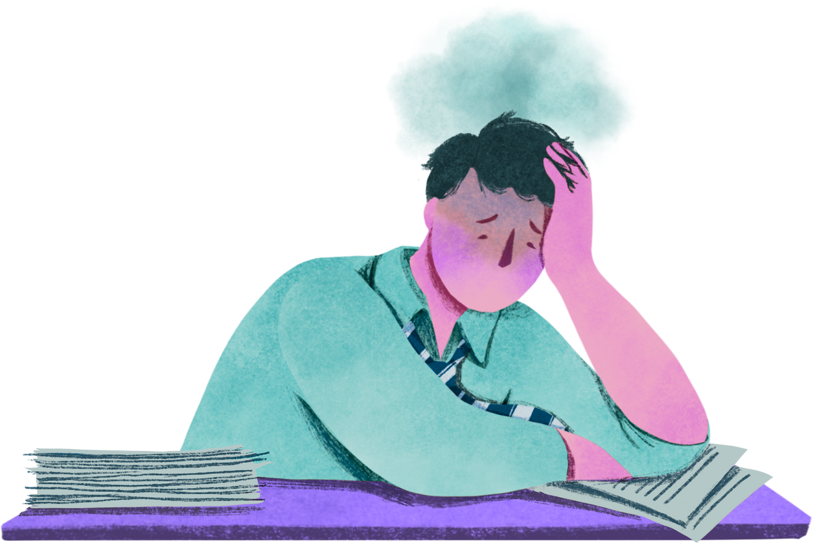
Impact of Working Over 40 Hours on Health

Slide 8
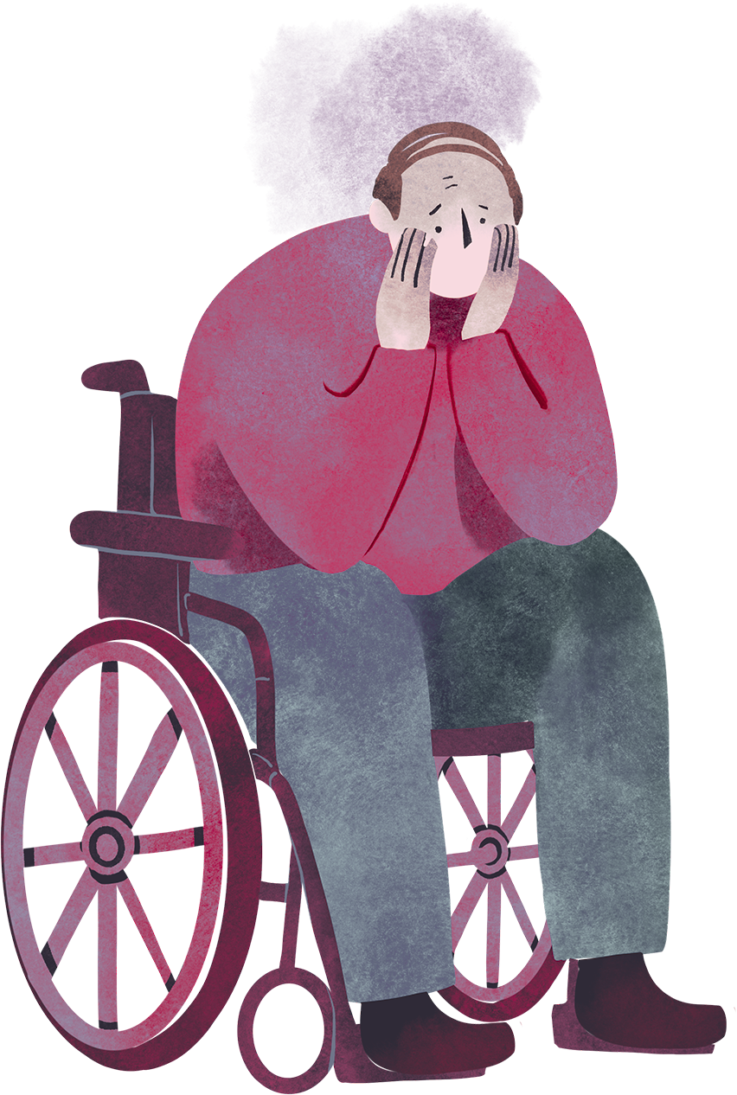
Common Physical & Mental
Health Issues
Back Pain
PTSD
Eye Strain
Shoulder Pain
Burnout
ADHD
Wrist Pain
Stress Disorder

Slide 9
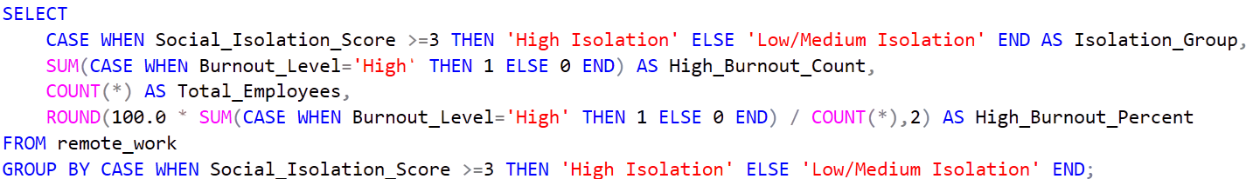
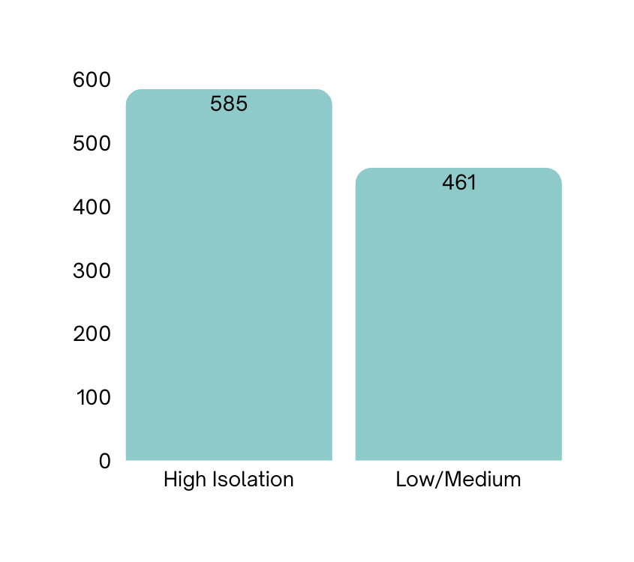
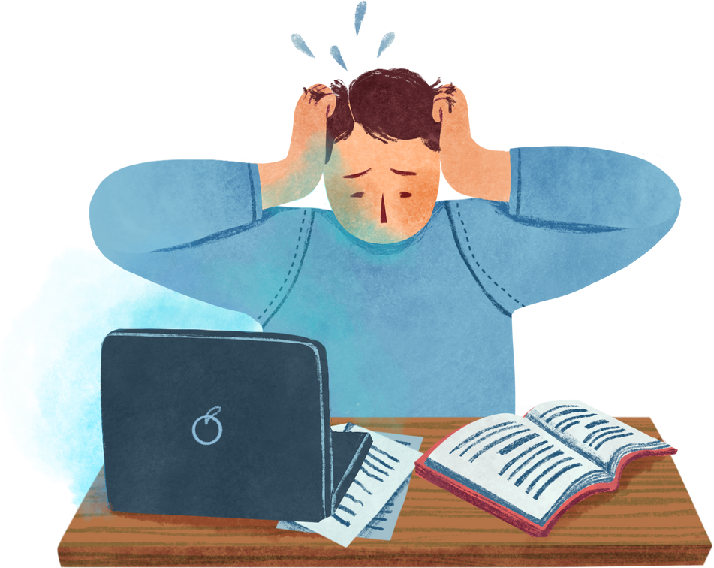
Is higher social isolation linked to
High Burnout?

Slide 10
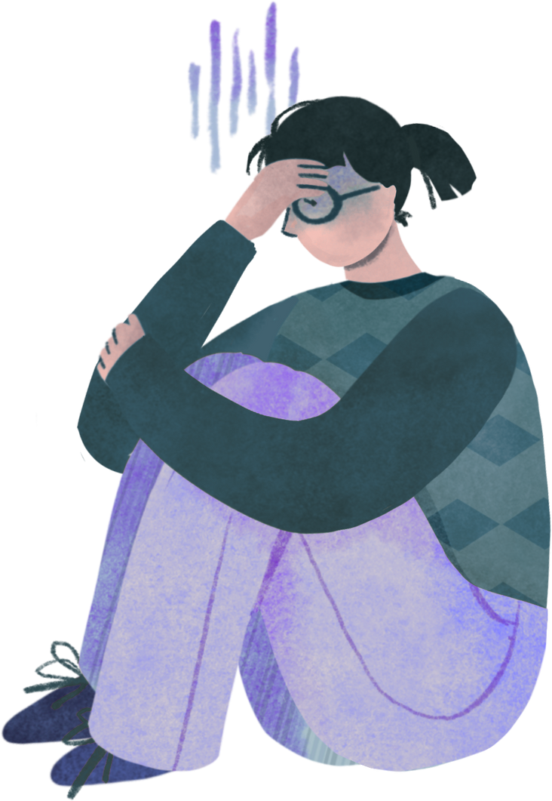
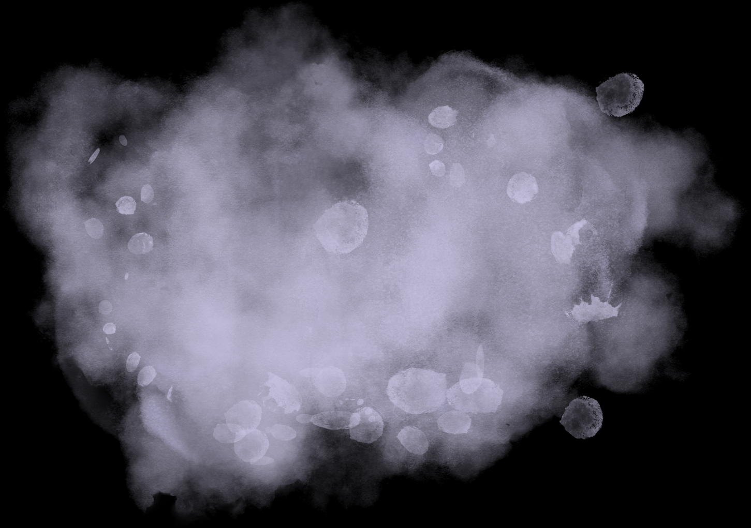
Which
gender
experiences the highest level of
burnout?
Female
Medium | 639
High | 515
Low | 346
Male
Medium | 680
High | 490
Low | 365

Slide 11

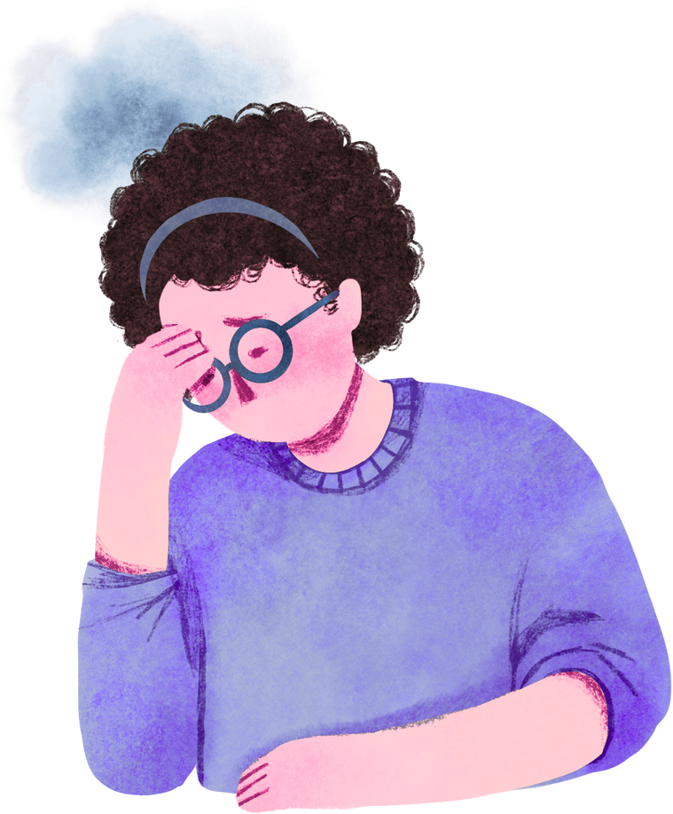
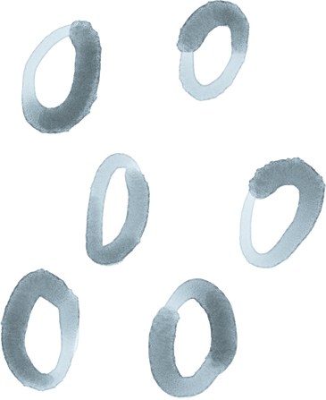

Conclusion
Longer Hours, Higher Risk: Employees working more than 40 hours per week report significantly more physical and mental health issues, highlighting the strain of extended workweeks.
Work Mode Matters: Remote and hybrid workers generally report less work-life balance, while fully onsite employees tend to experience higher burnout and social isolation.
Isolation & Health: Higher social isolation scores strongly correlate with greater burnout and mental health concerns.
Key Takeaway:
Balancing workload, offering flexible work arrangements, and supporting mental health are critical for sustaining a healthy, productive workforce in the post-pandemic era.

Slide 12

THANK YOU

